Slide 1

IBM CAPSTONE PROJECT – The Battle of Neighborhoods: Cluster Analysis of Brooklyn Food Services - during a total lockdown in the New York City

Slide 2
Business Problem section
Brooklyn Restaurants are in a rut:
Lockdown
Population
Increasing Fuel Cost

Slide 3
Business Problem
How could we provide support to people who want to buy food from many restaurants in Brooklyn during the lockdown ?

Slide 4
Solution
To solve this business problem, we are going to cluster Brooklyn neighborhoods in order to recommend venues people can buy food. We will recommend profitable venues according to amenities and essential facilities surrounding.

Slide 5
Data and Methodology
Data: merging data on Brooklyn properties and the relative price paid data from all restaurantstry and data on amenities and essential facilities surrounding such properties from FourSquare API interface.
Mehodology:
Collect Inspection Data;
Explore and Understand Data;
Data preparation and preprocessing;
Modeling

Slide 6
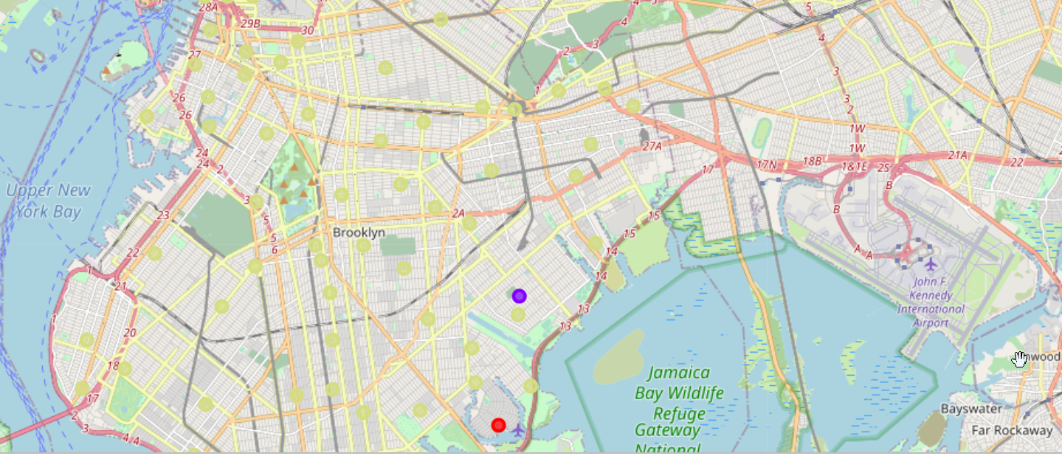
K-Means clustering

Slide 7

Outcome:
Brooklyn need food services potentially because there are a lot of restaurants which have no food service but have customers.
Brooklyn is the best place to stay if you prefer to run in business on food services.
It is observed that Brooklyn is the second city which has huge number of neighborhoods, so we go on our analysis with Brooklyn.
As far as we search from our cluster data, we decide that we will form a new data frame called "result first" from first cluster (cluster label=0) because it has most neighborhood.
We got 2745 neighborhoods which are so close to each other according to their properties.

